Slide 1
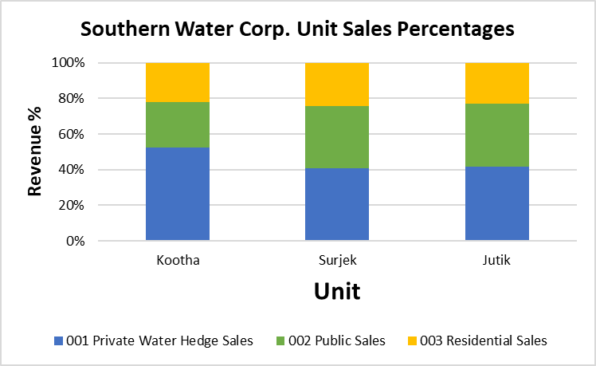
Segmentation of the revenues by unit, reveals that of the three (3) customer segments, Private ($187 M) are the most popular, followed by Public ($147 M) and lastly Residential Sales ($102 M).

Slide 2
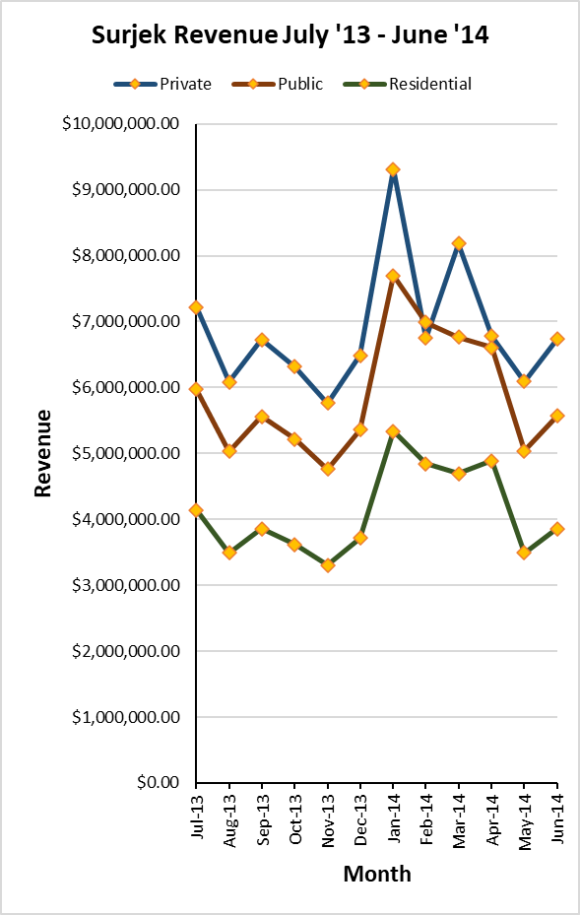
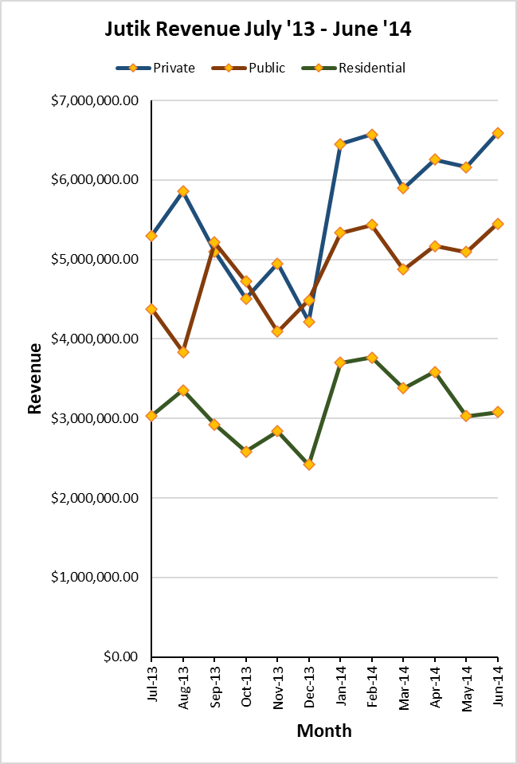
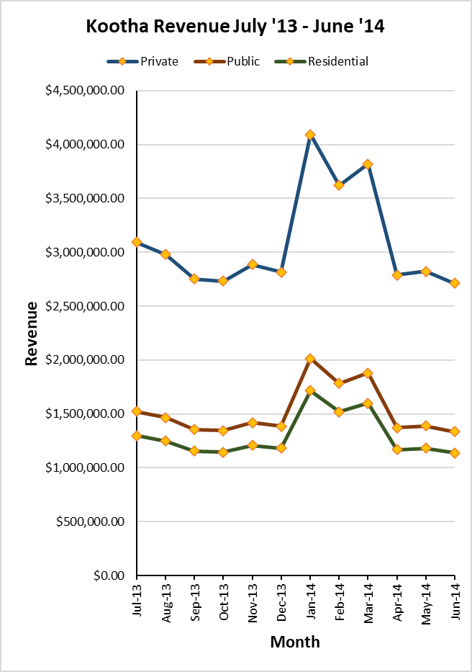
Of the ($437 M) in Revenue Sales over the July-2013 to June-2014 Period, Surjek provides close to 50% of Sales Volumes ($202 M), with Jutik ($164 M) and Kootha ($71 M) providing the remaining.

Slide 3
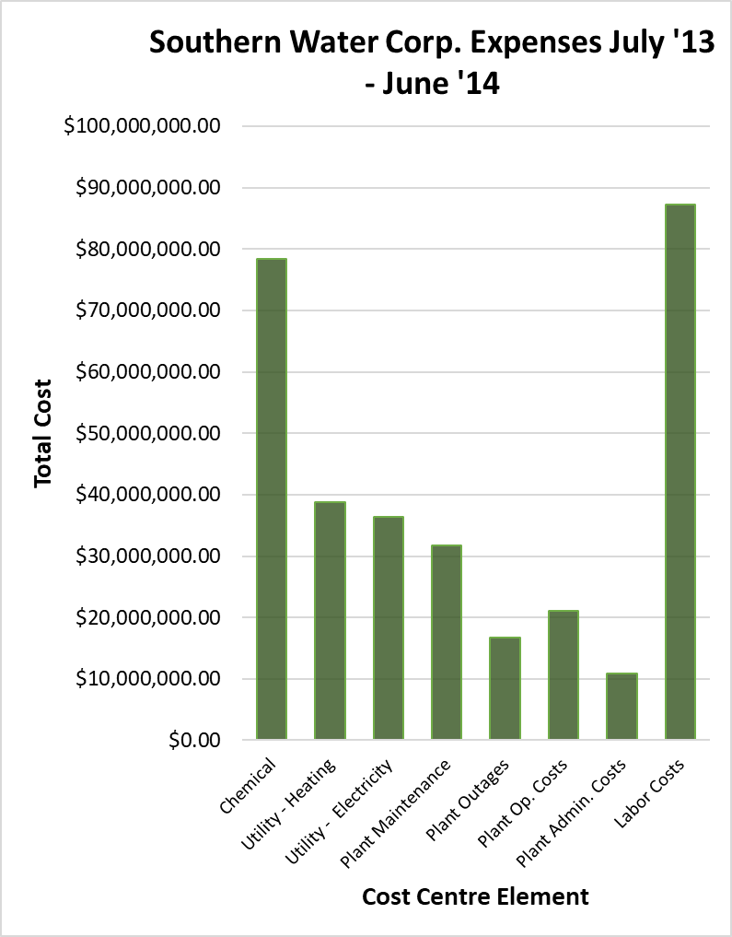
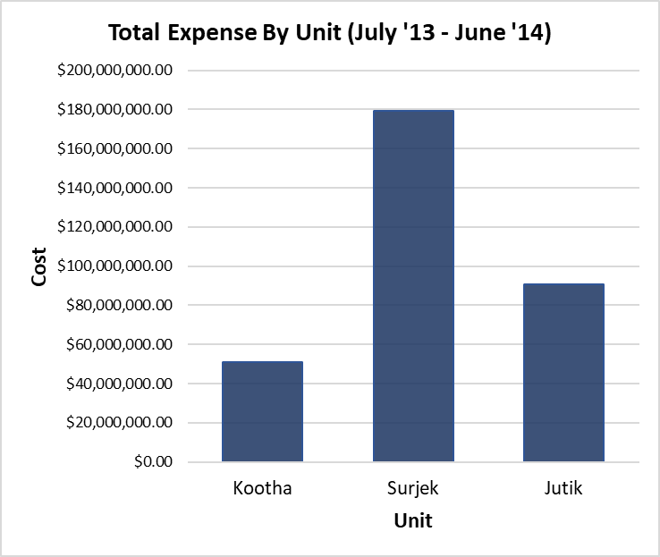
Targeted Expense Analysis reveals an interesting trend; Overall Costs sharply increase from December, with Chemical Expenses contributing $78.4 M (24.4%) towards the overall cost-base.

Slide 4
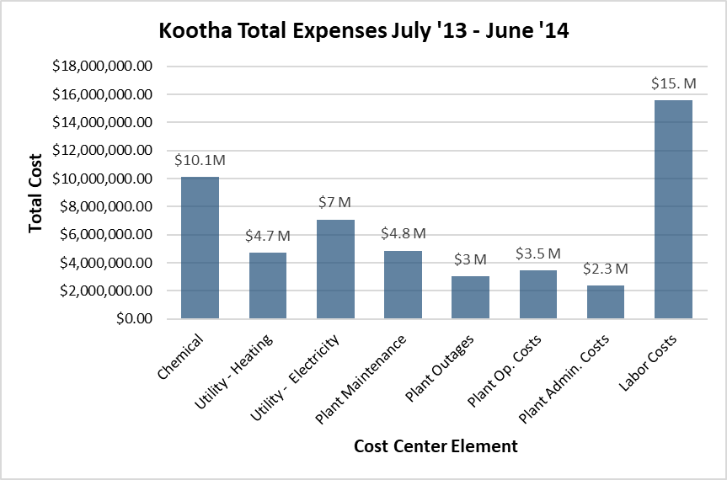
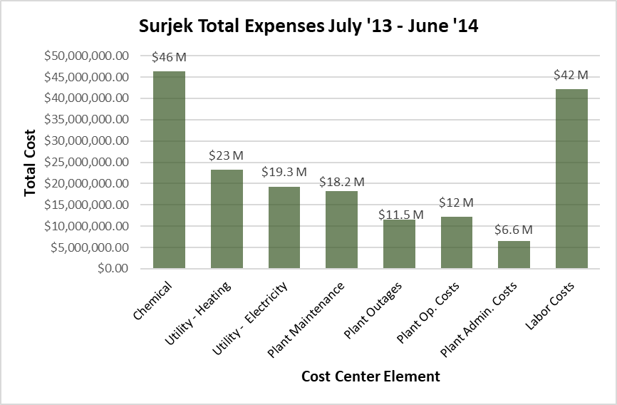
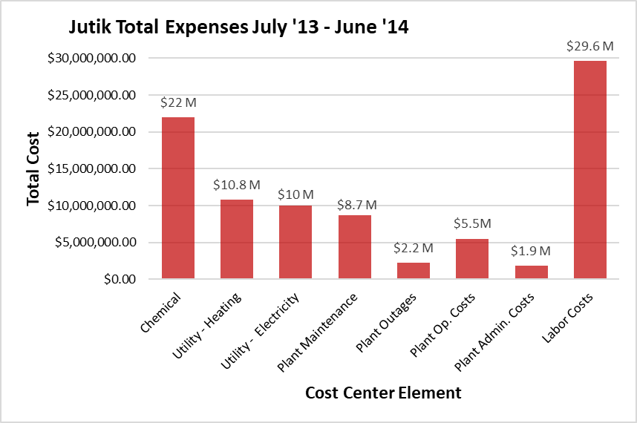
Further analysis singles-out Surjek with $179 M (55.8%) worth of expenses, contrasted to a much lower spend from Kootha ($51 M) and Jutik ($91 M), largely due to lower Chemical and Labour Expenditure.

Slide 5
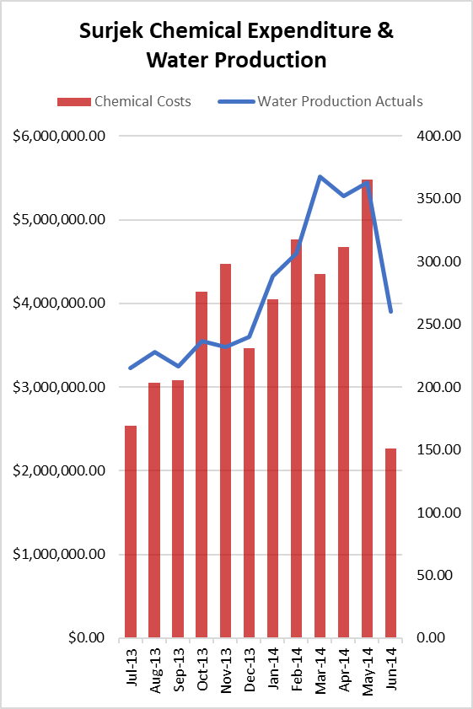
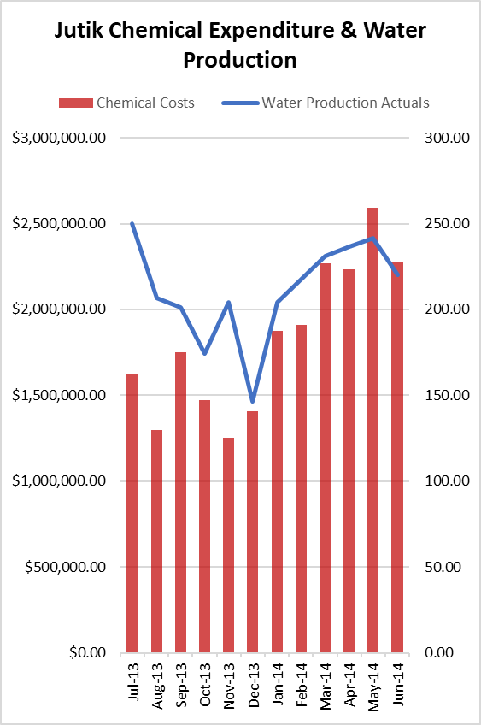
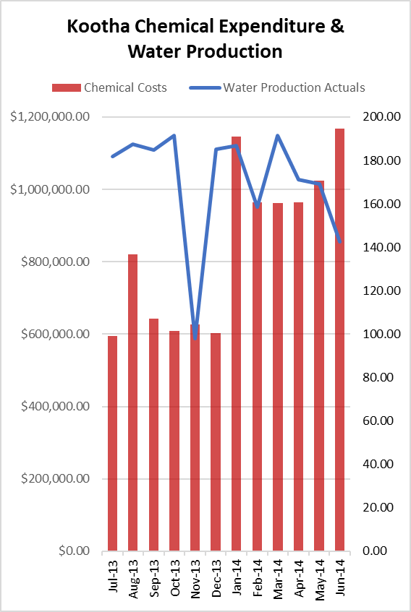
Drilling-down to the cost-element level, reveals an indicative relationship between water production and chemical expenditure with this being particularly pronounced for the Surjek Unit which coincidentally has the highest rate of water production.

Slide 6
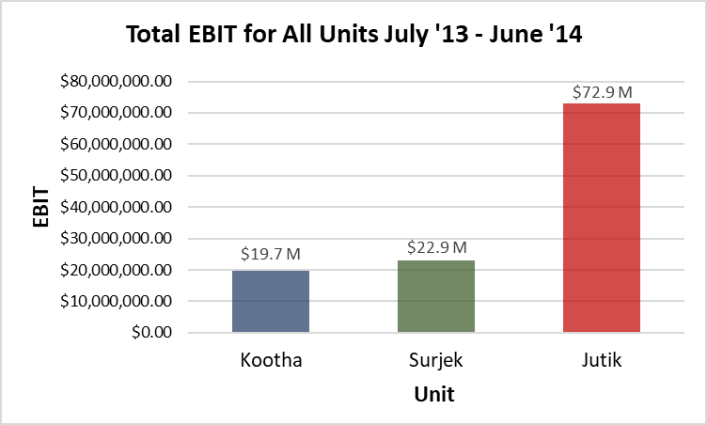
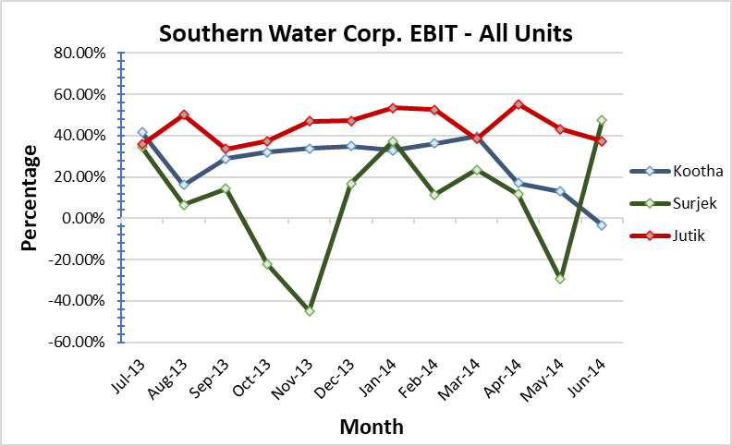
Concluding our analysis, Jutik has the highest overall EBIT contributions ($73 M), followed by Surjek ($23 M) , and lastly Kootha ($20 M). However, from an EBIT Margin (%) perspective, Kootha has a higher margin than that of Jutik, indicative of a lower revenue-to-expense ratio.¹
Note:¹ We can clearly see for Surjek over the October, November and May Periods – expenses were far higher than revenues which contributed to this lower revenue-to-expense ratio.

